Slide 1

Development of a Five Axis Robot Arm implemented using a PIC Microcontroller and LabVIEW Robotics 2010
Akanksha Bahuguna
Ayush Dewan
Saurav Gusain
Souri Guha
Applied Electronics and Instrumentation
2011 Batch

Slide 2
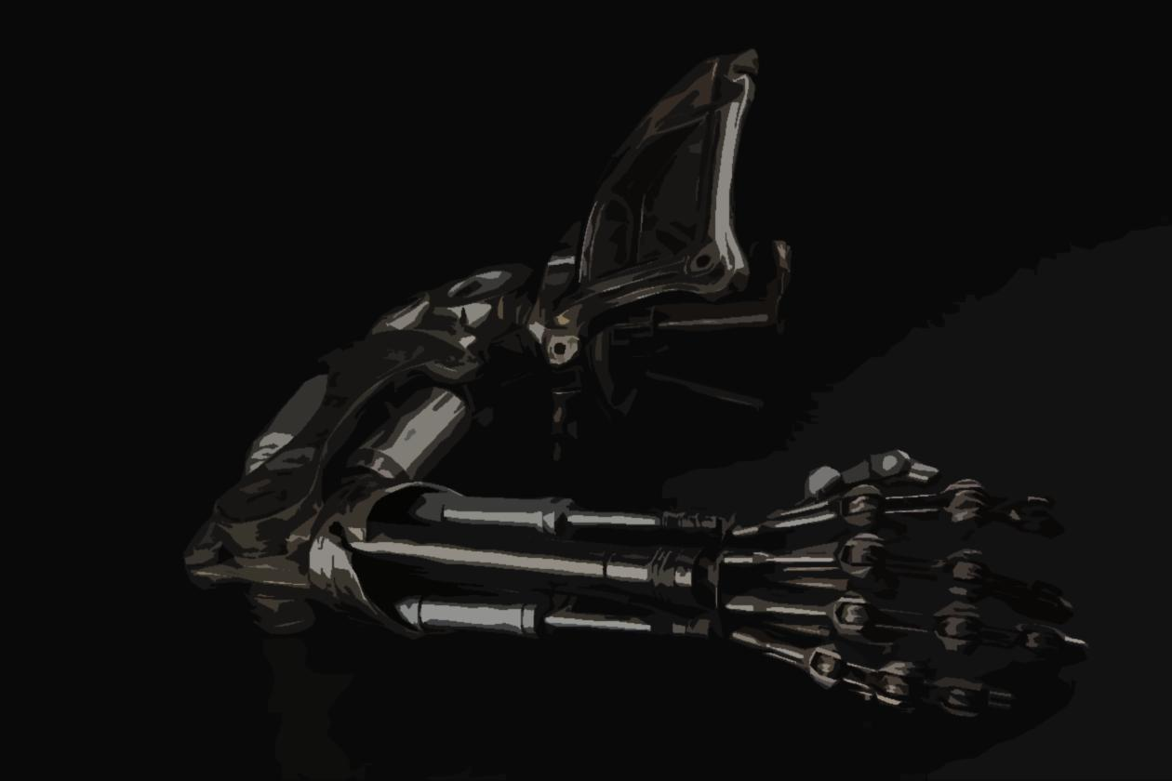
Our aim is to build a 4-axis Robot Arm
The motion of the Arm will be controlled by a PIC Microcontroller that will communicate on a real time basis with LabVIEW which will do the calculations
Our Objective
The basic function of the device will be to pick and place small objects

Slide 3
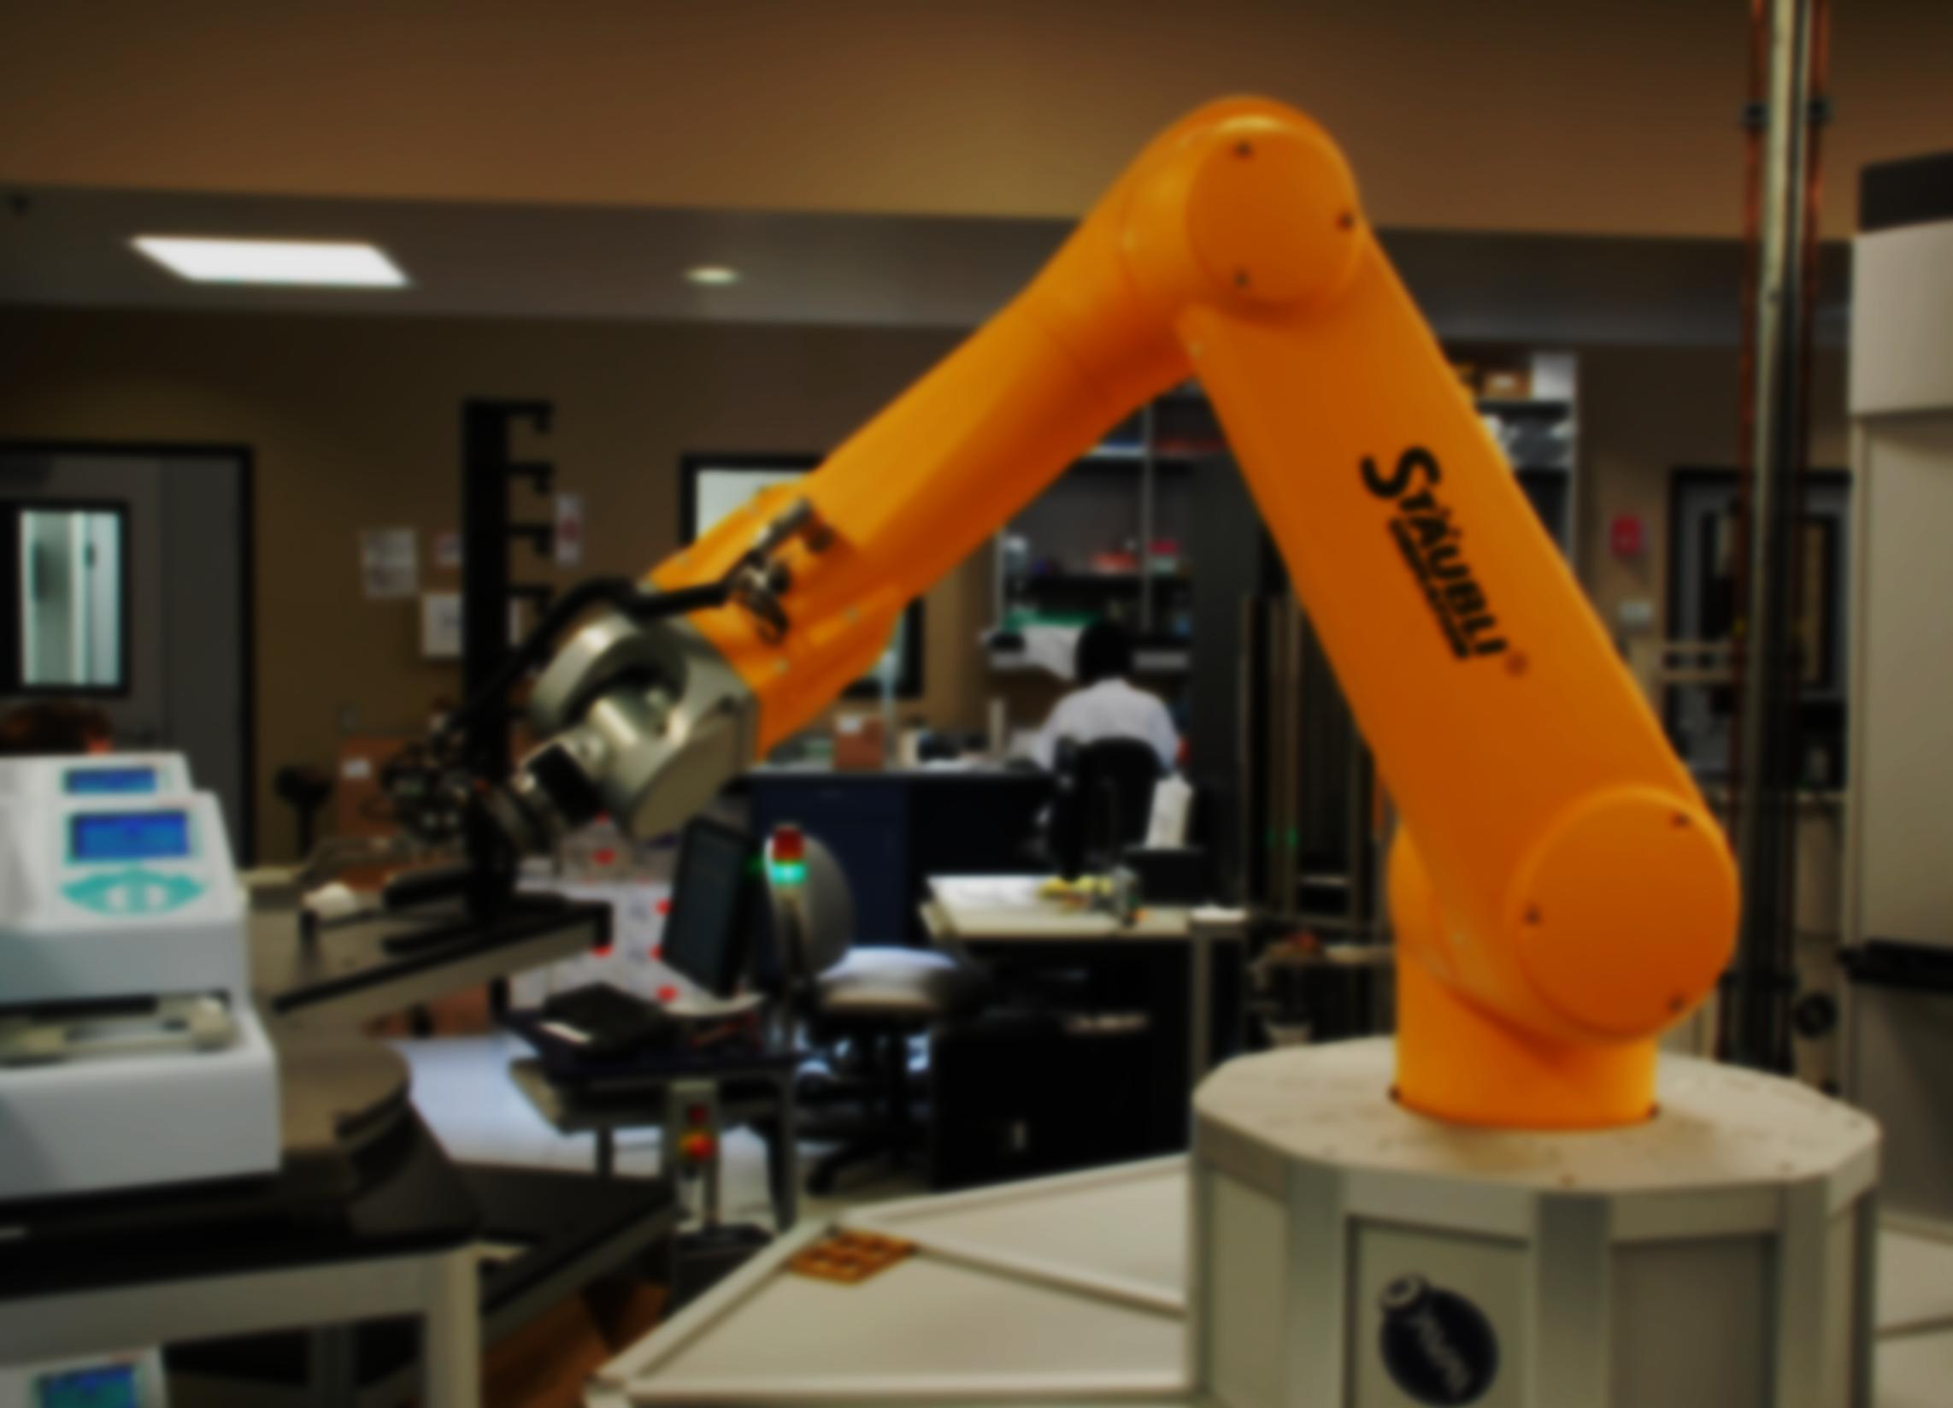
Concept & Motivation
What we wanted
The big picture
Visualization
Distribution of Work
Mechanical Design
Resources and help
Design stages
Logic Overview
It’s all about building an intelligent device!
Electronic Design
Components we needed
Getting them to talk to each other
Development of the PCB
Programming the Brains of the Robot
Why LabVIEW?
Interfacing PIC with LabVIEW
Moving the first Motor
Remaining Work
Project Budget
ETA
Resources
Agenda

Slide 4
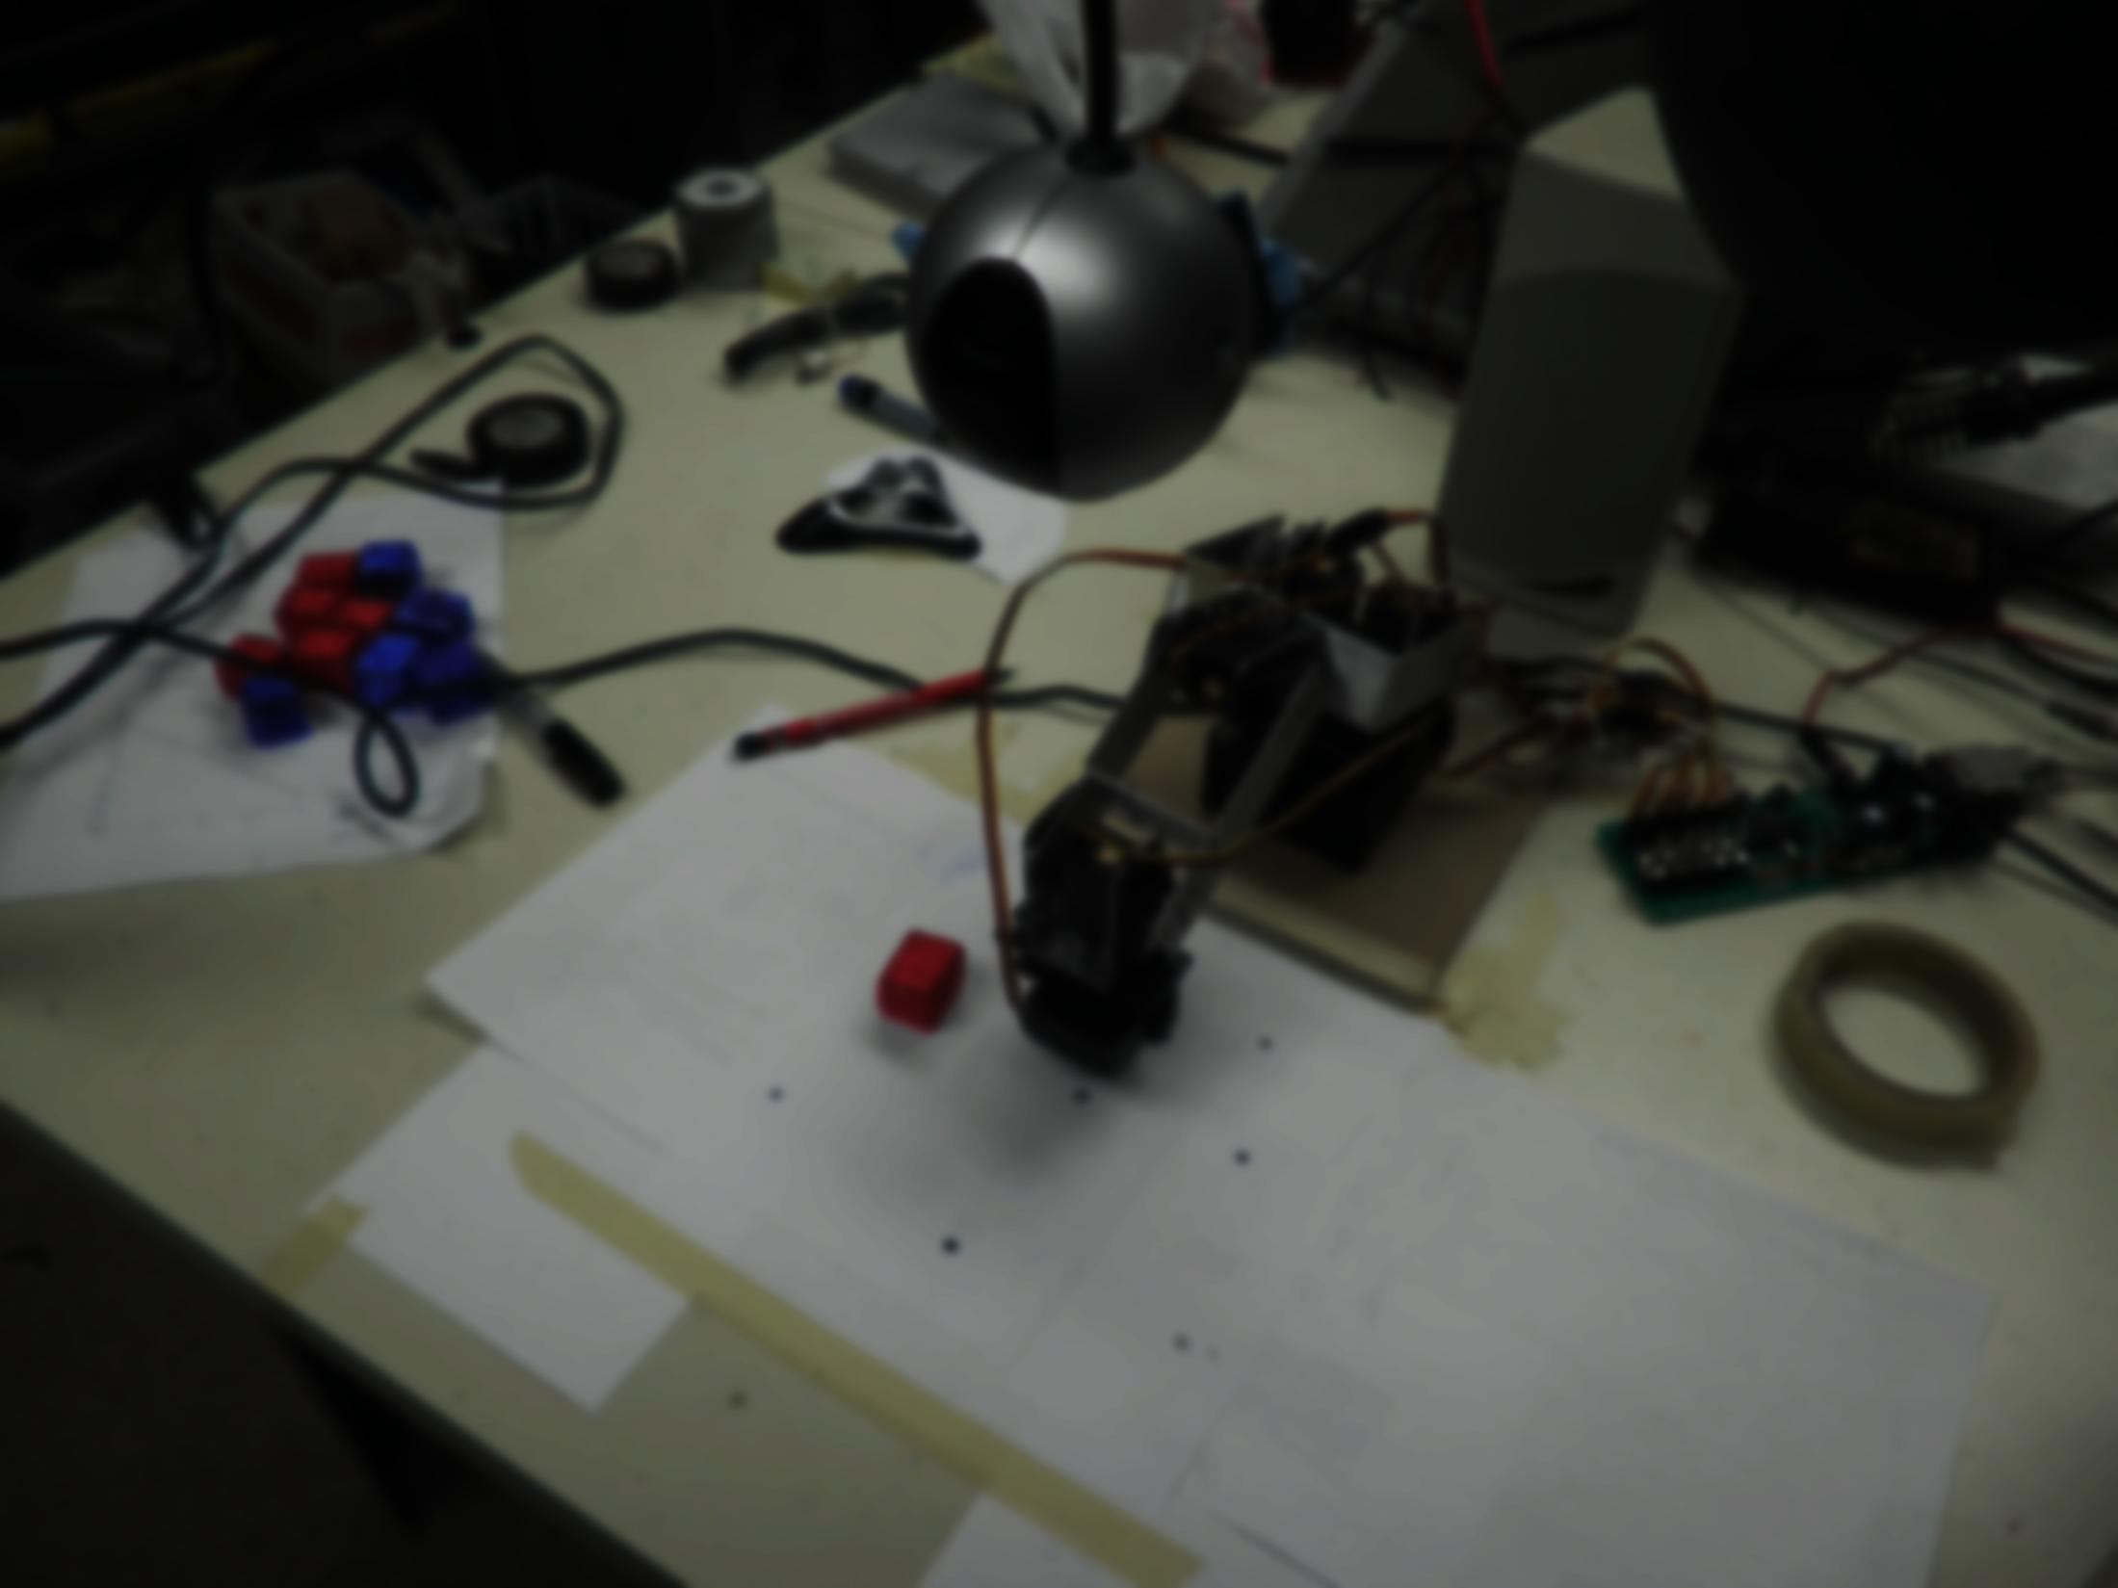
The design should be simple yet complex/stable enough for Industrial Applications and for R&D of various algorithms used in Robotics
High grade Accuracy and Speed
Easy to modify
Should be able serve the purpose of Educational Robotics
What we wanted when we thought of building the Robot
A prototype for a device that is ready to be used in Industry

Slide 5
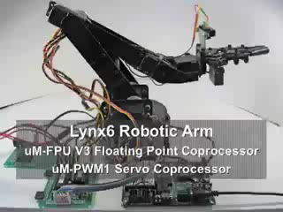
Motivation

Slide 6
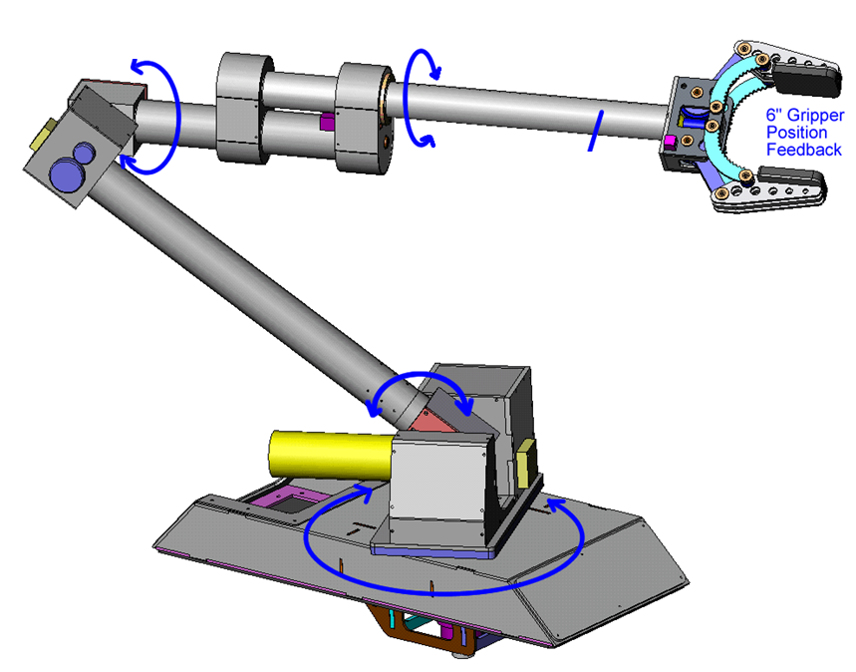
First Level Visualization

Slide 7
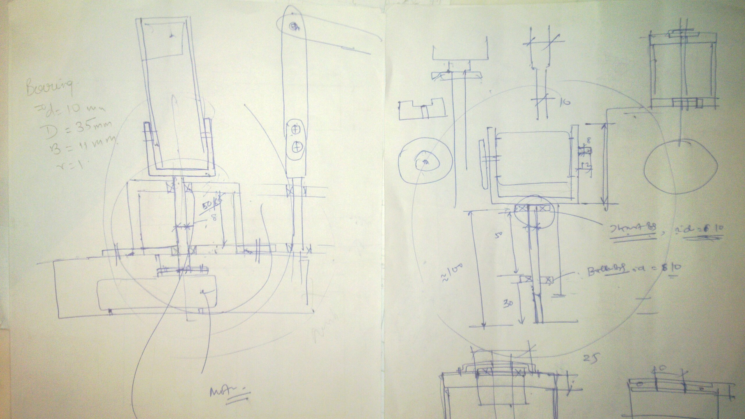

Slide 8

Acquisition of relevant data Akanksha, Ayush, Souri, Saurav
Research on different Design types and choosing the best possible Akanksha, Saurav
Decide Robot Parameters Ayush
Verification of Parameters in Robotics Toolbox for MATLAB Souri
Simulation of all devices in PROTEUS Ayush, Souri
Implementation of Arm Parameters in LabVIEW 2010 Ayush, Souri
Re-Verification of Arm Parameters in LabVIEW 2010 Saurav, Akanksha
Mechanical Design of Robot Souri
Manufacturing of Robot Saurav, Ayush
PCB Design for Robot Souri , Akanksha
PCB Manufacture Akanksha
Selection of Servo Motors Saurav
Calibration of Motors Souri
PID Control Design and Implementation of different Modes Souri, Ayush, Akanksha, Saurav
Improvisation Ayush, Souri, Akanksha, Saurav
Implement further use cases and extend funcionality Souri, Ayush
Completed
Ongoing
Left
Distributed Resposibilities

Slide 9
Initial Design
Revisions
Development of Parts
Assembly Design
Mechanical Design
Resource: MIT OpenCourseware Video Lectures

Slide 10
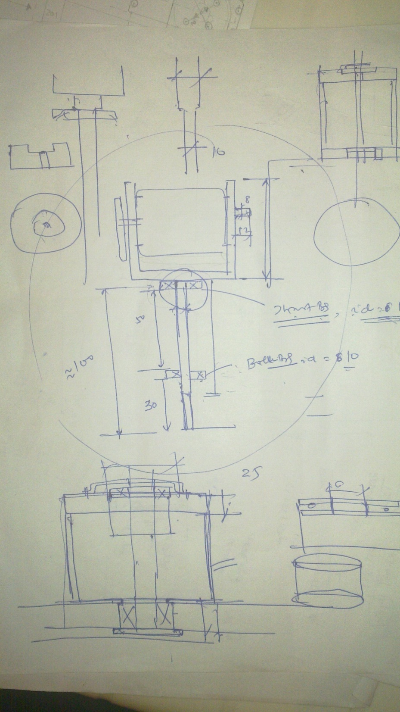

Slide 11
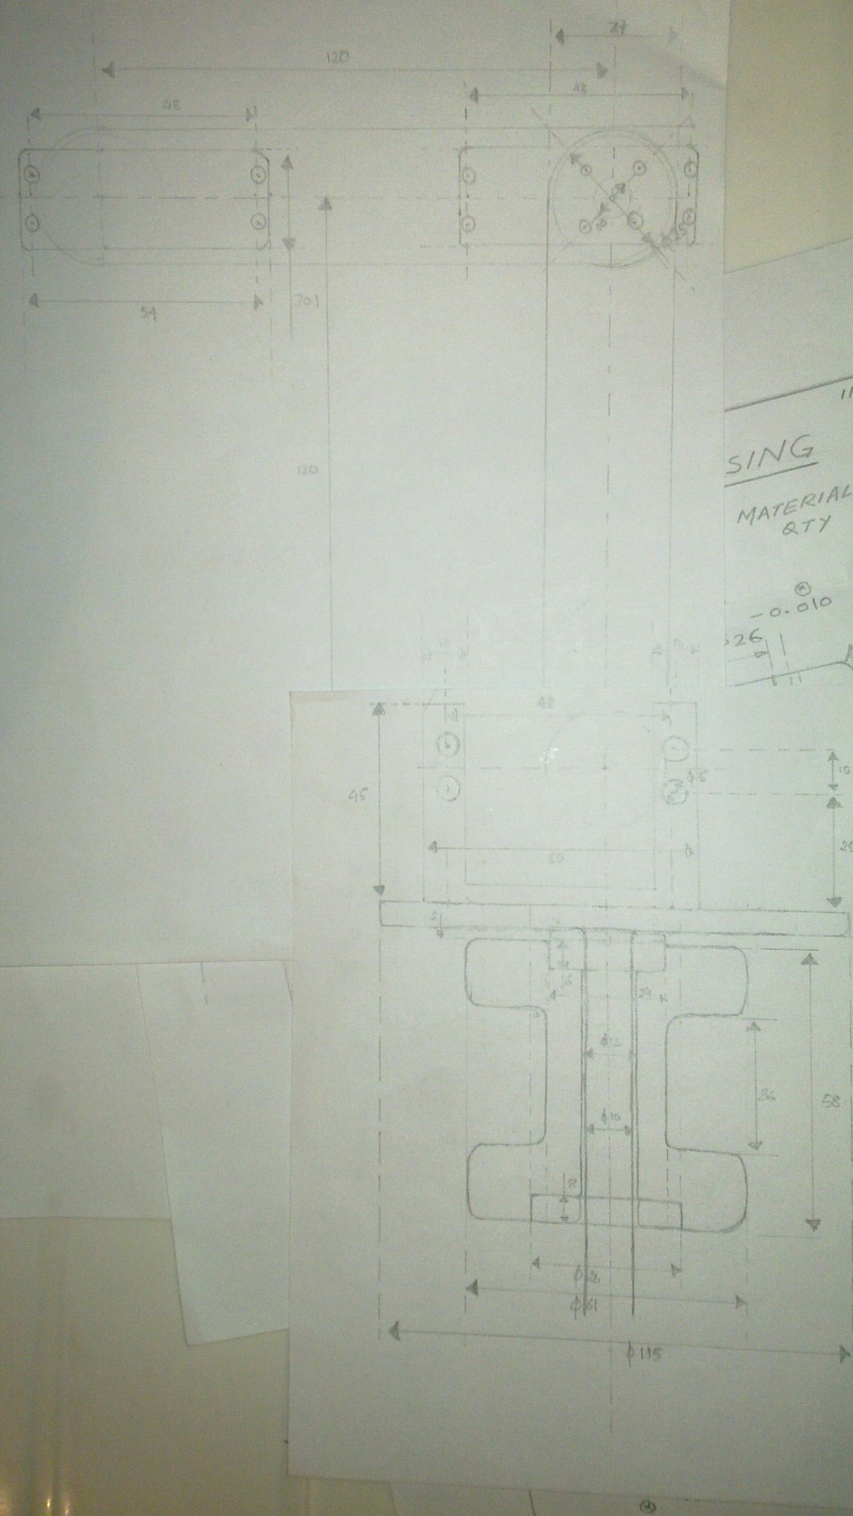

Slide 12
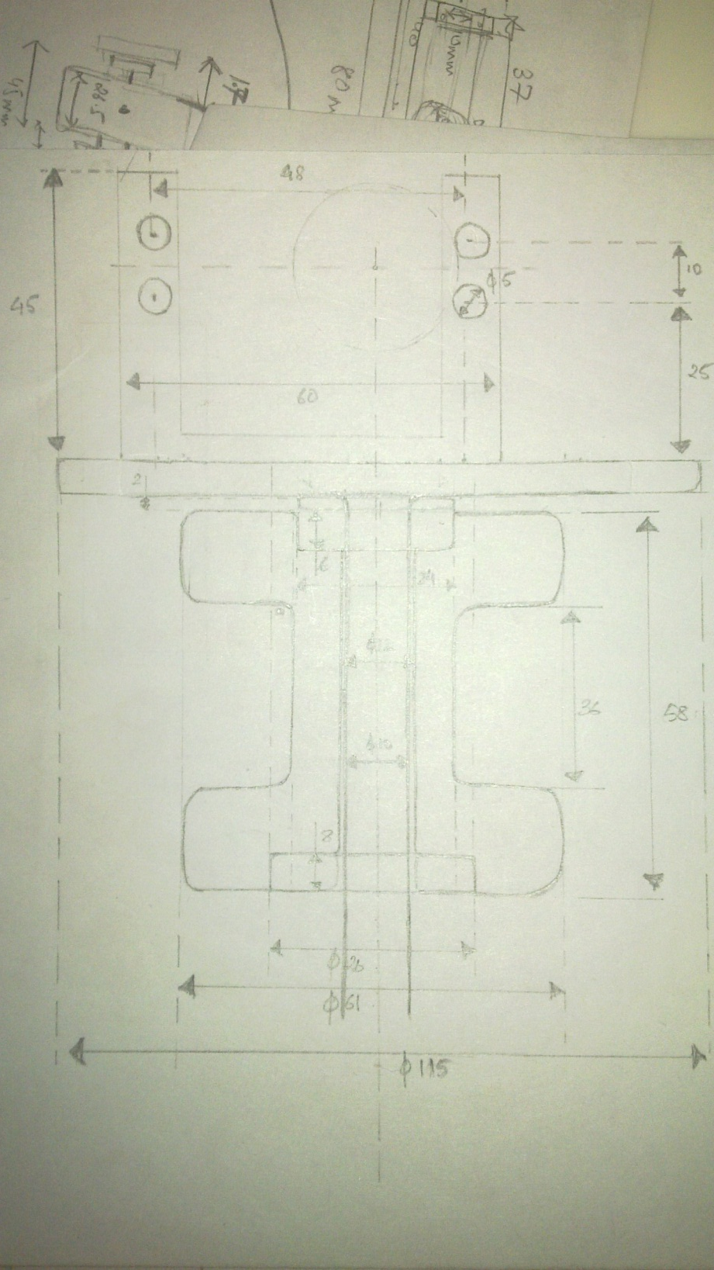

Slide 14
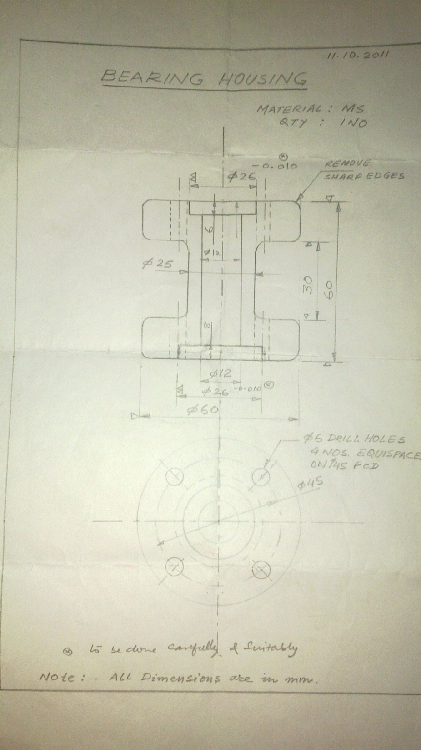

Slide 15
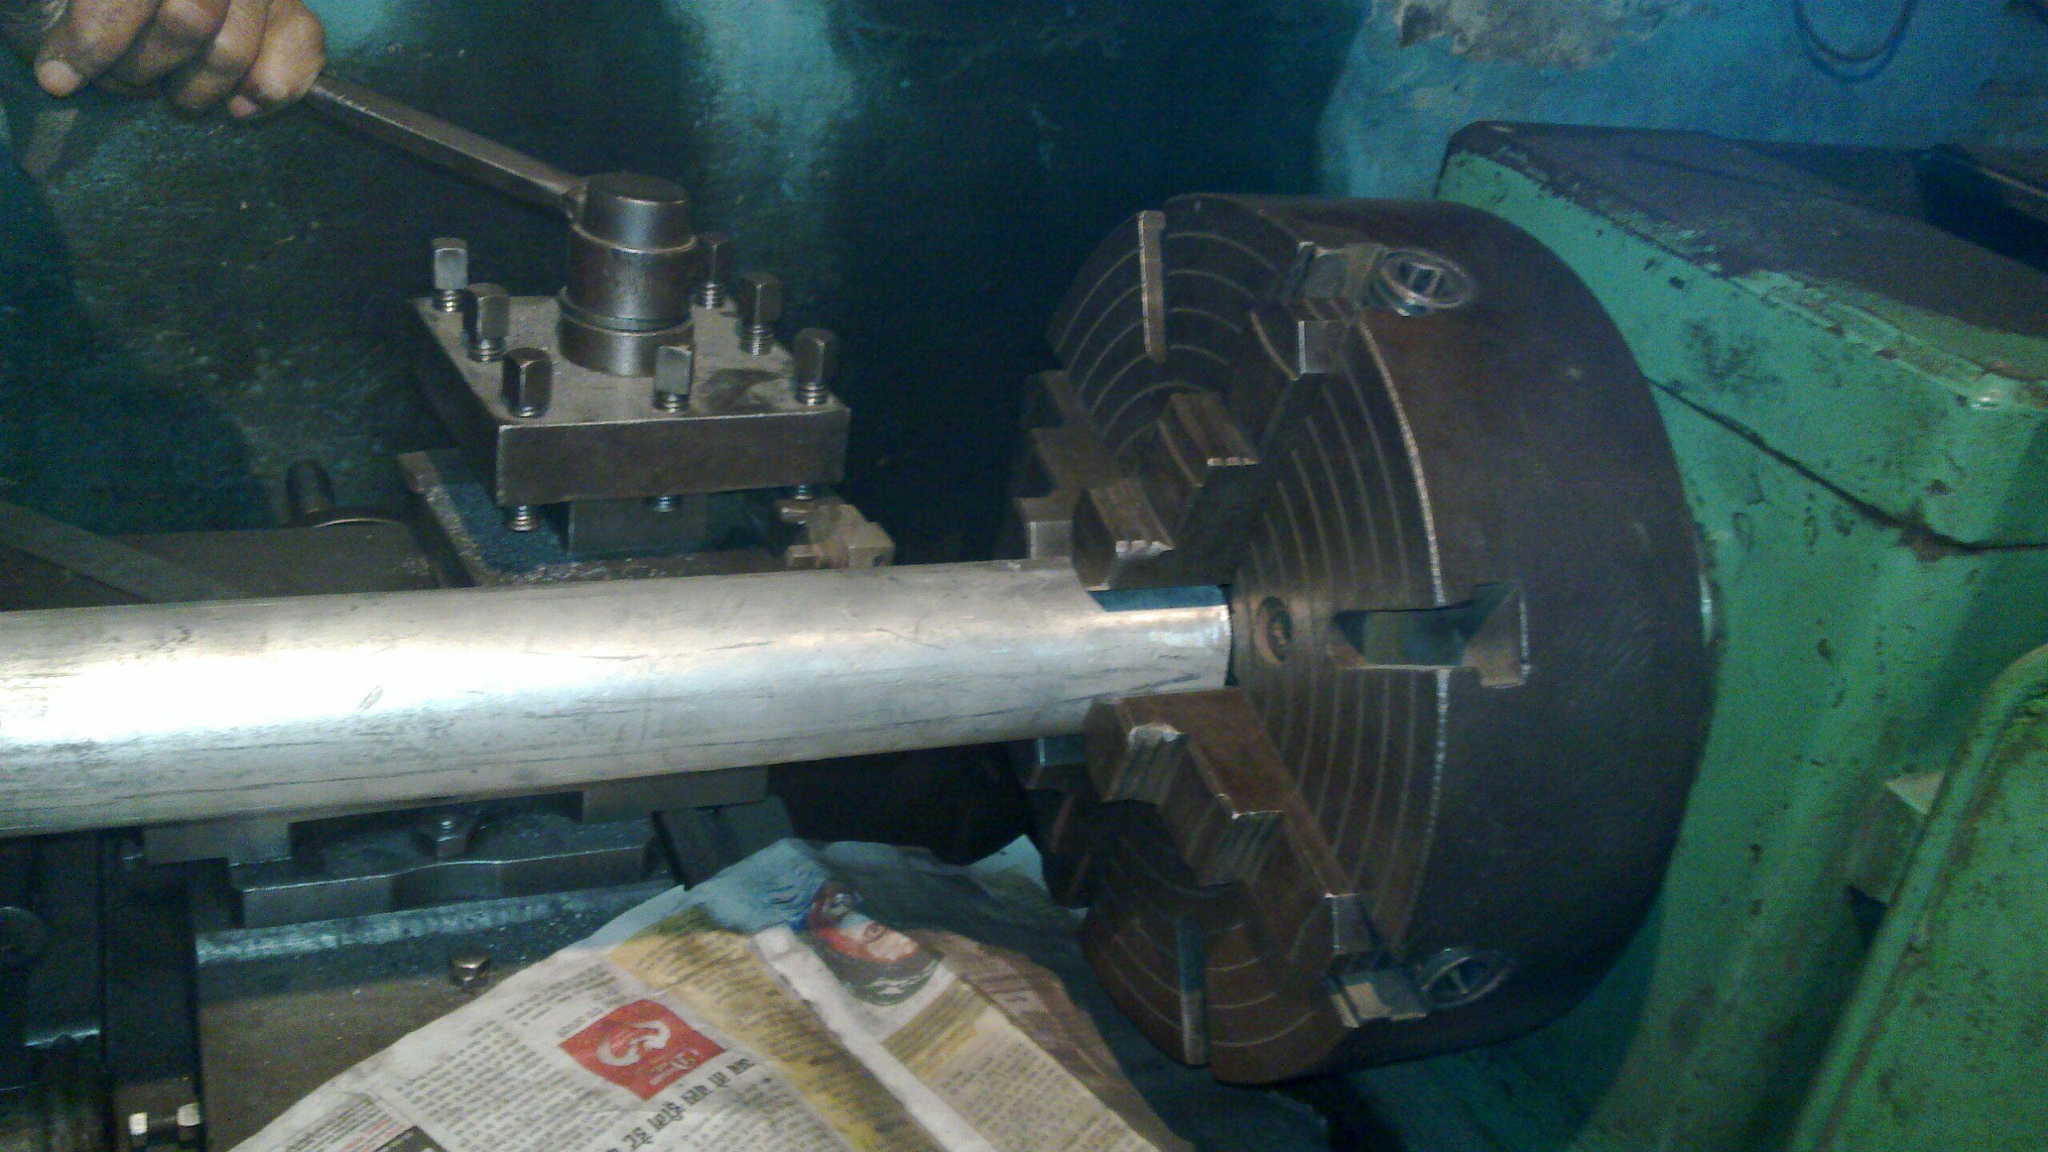

Slide 16
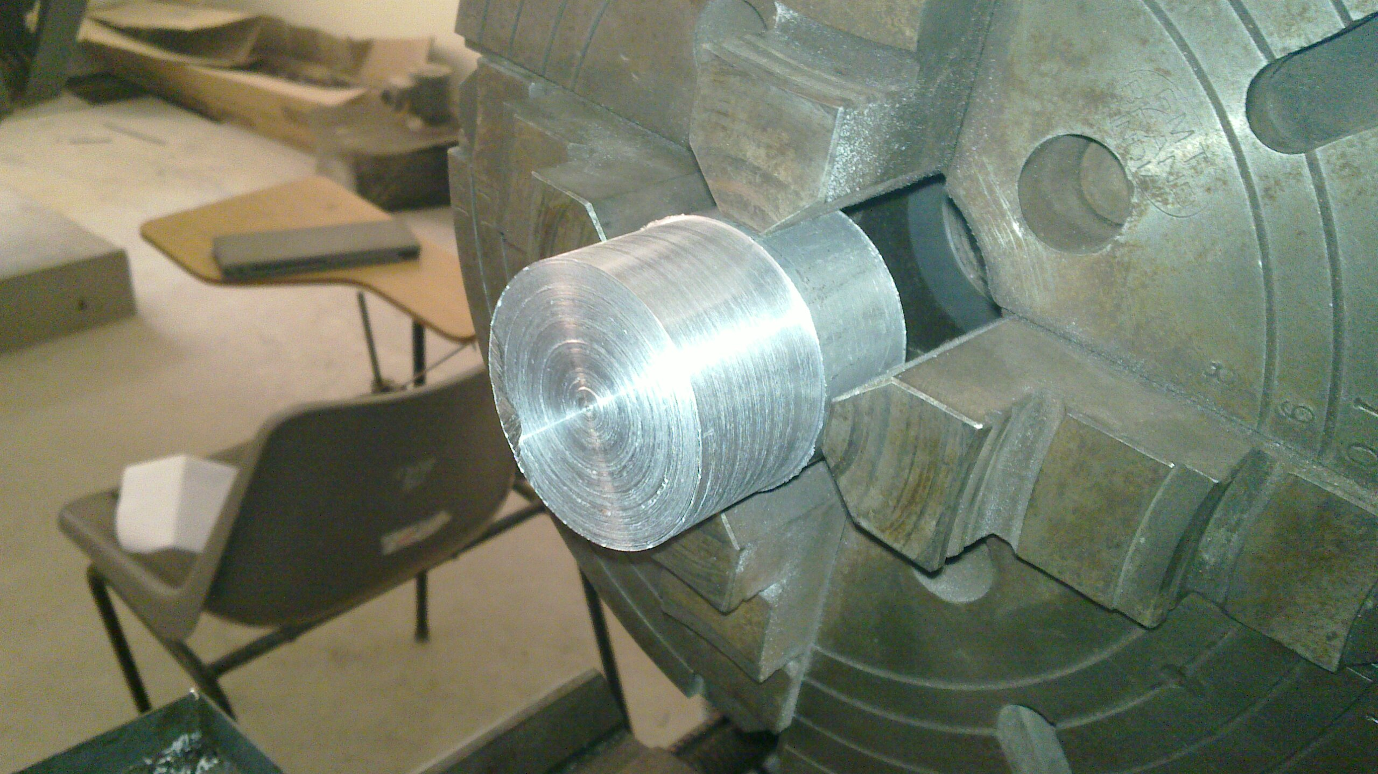

Slide 17
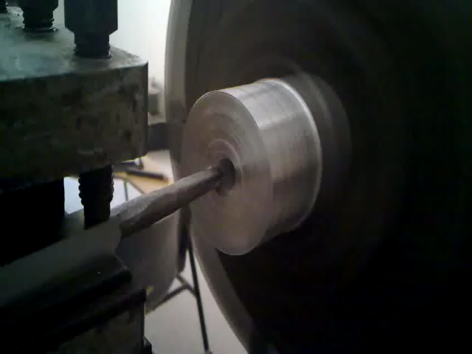

Slide 18
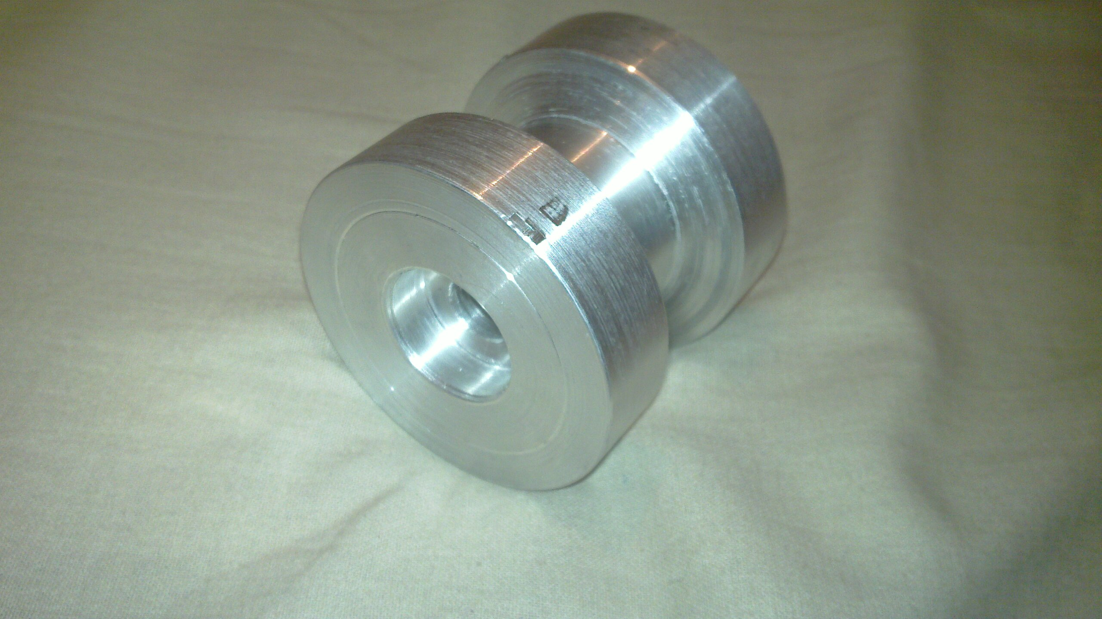

Slide 19
Concept & Motivation
What we wanted
The big picture
Visualization
Distribution of Work
Mechanical Design
Resources and help
Design stages
Logic Overview
It’s all about building an intelligent device!
Electronic Design
Components we needed
Getting them to talk to each other
Development of the PCB
Programming the Brains of the Robot
Why LabVIEW?
Interfacing PIC with LabVIEW
Moving the first Motor
Remaining Work
Project Budget
ETA
Resources
Agenda

Slide 20
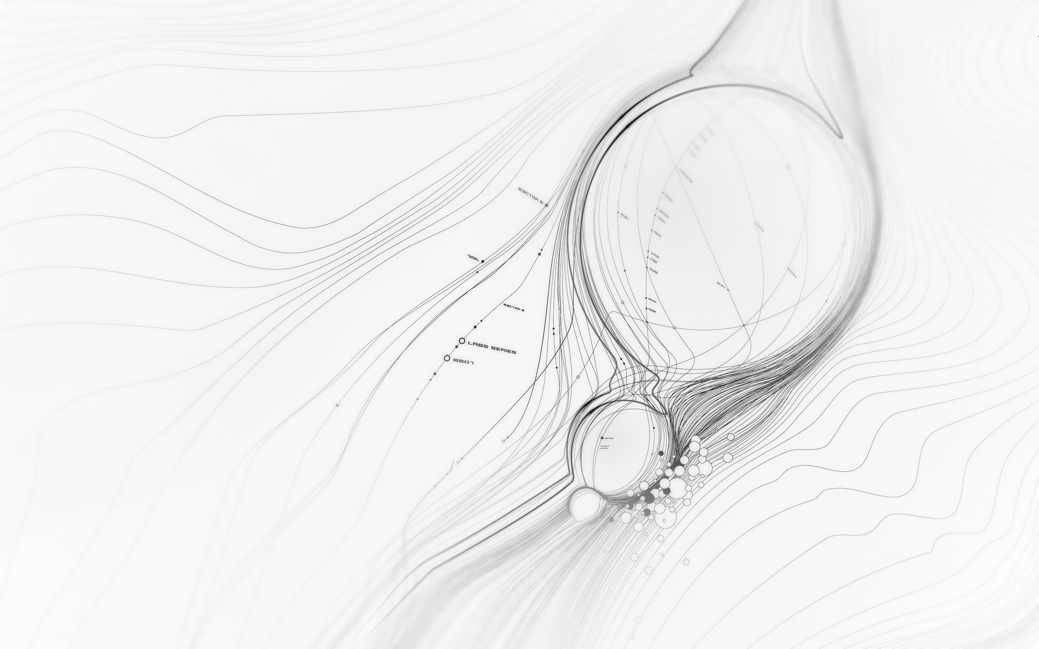
Servo 1
Servo 2
Servo 3
Multiple Quadrature Encoders
PIC Microcontroller
Servo 4
Servo 5
Ethernet/Serial Bus
Grip Servo
Computer
Architecture of our Robot Arm

Slide 21
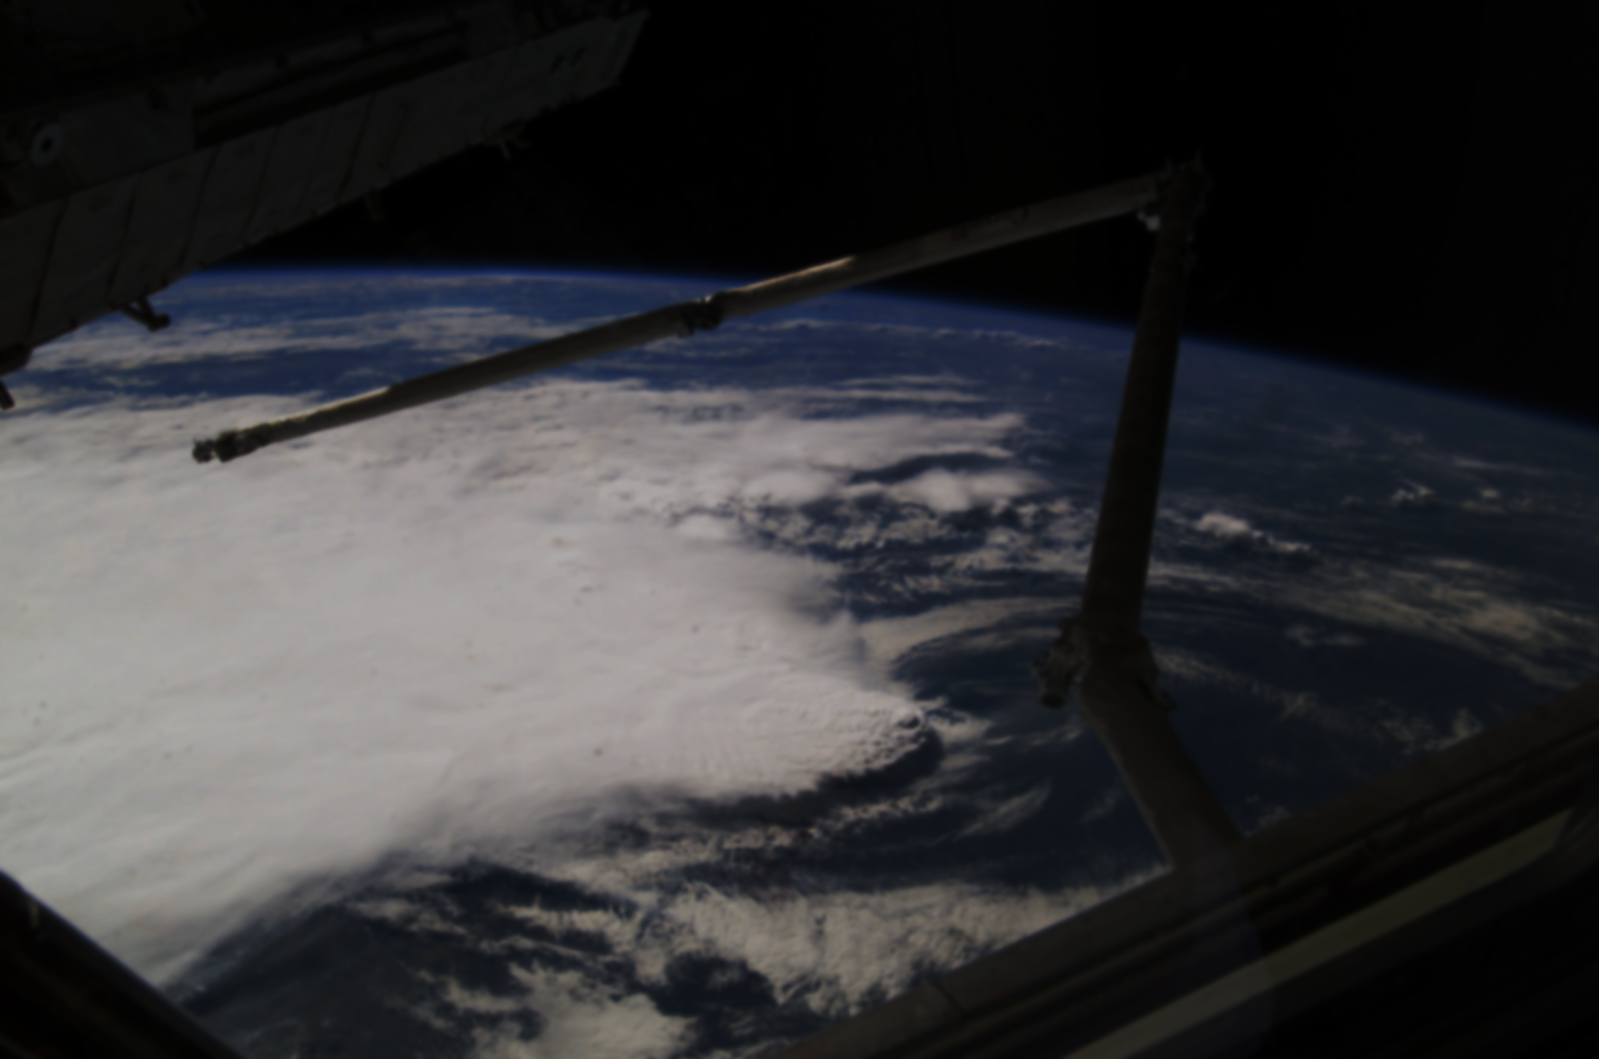
Formatted Feedback Data from Microcontroller
Predefined Robot Structure
LabVIEW Robotics
Inverse Kinematics Calculation
PID Control Logic
Software Architecture of the Robot
LabVIEW Robotics
Compatible Hardware
Required Functionality
Formatted Output Data from PC
Setpoint

Slide 22
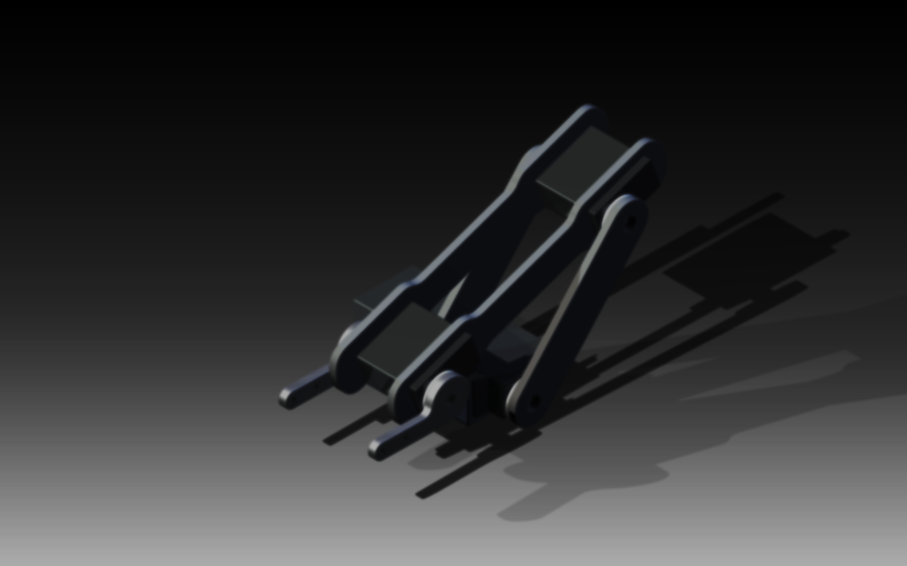
Modes
Learning
Automatic
Manual
Manipulation of the Robot Arm

Slide 23
Concept & Motivation
What we wanted
The big picture
Visualization
Distribution of Work
Mechanical Design
Resources and help
Design stages
Logic Overview
It’s all about building an intelligent device!
Electronic Design
Components we needed
Getting them to talk to each other
Development of the PCB
Programming the Brains of the Robot
Why LabVIEW?
Interfacing PIC with LabVIEW
Moving the first Motor
Remaining Work
Project Budget
ETA
Resources
Agenda

Slide 24
1. PIC Microcontroller
2. Servo Motors
3. LCD (for Debugging)
4. Serial/Ethernet Interface
Components we needed
5. EEPROM

Slide 25
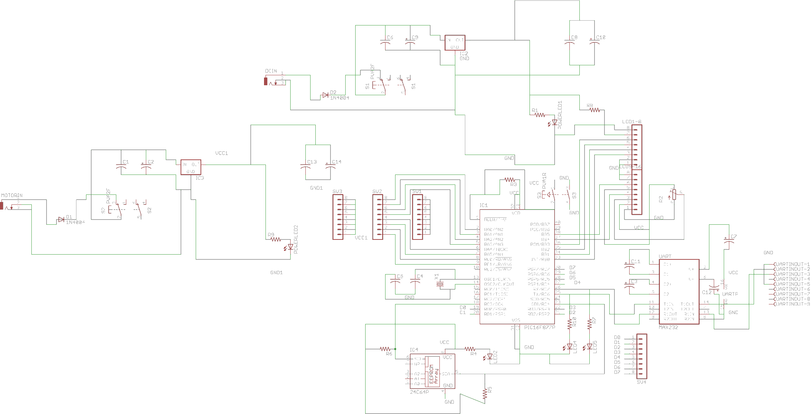
Design of the Schematic on EAGLE

Slide 26
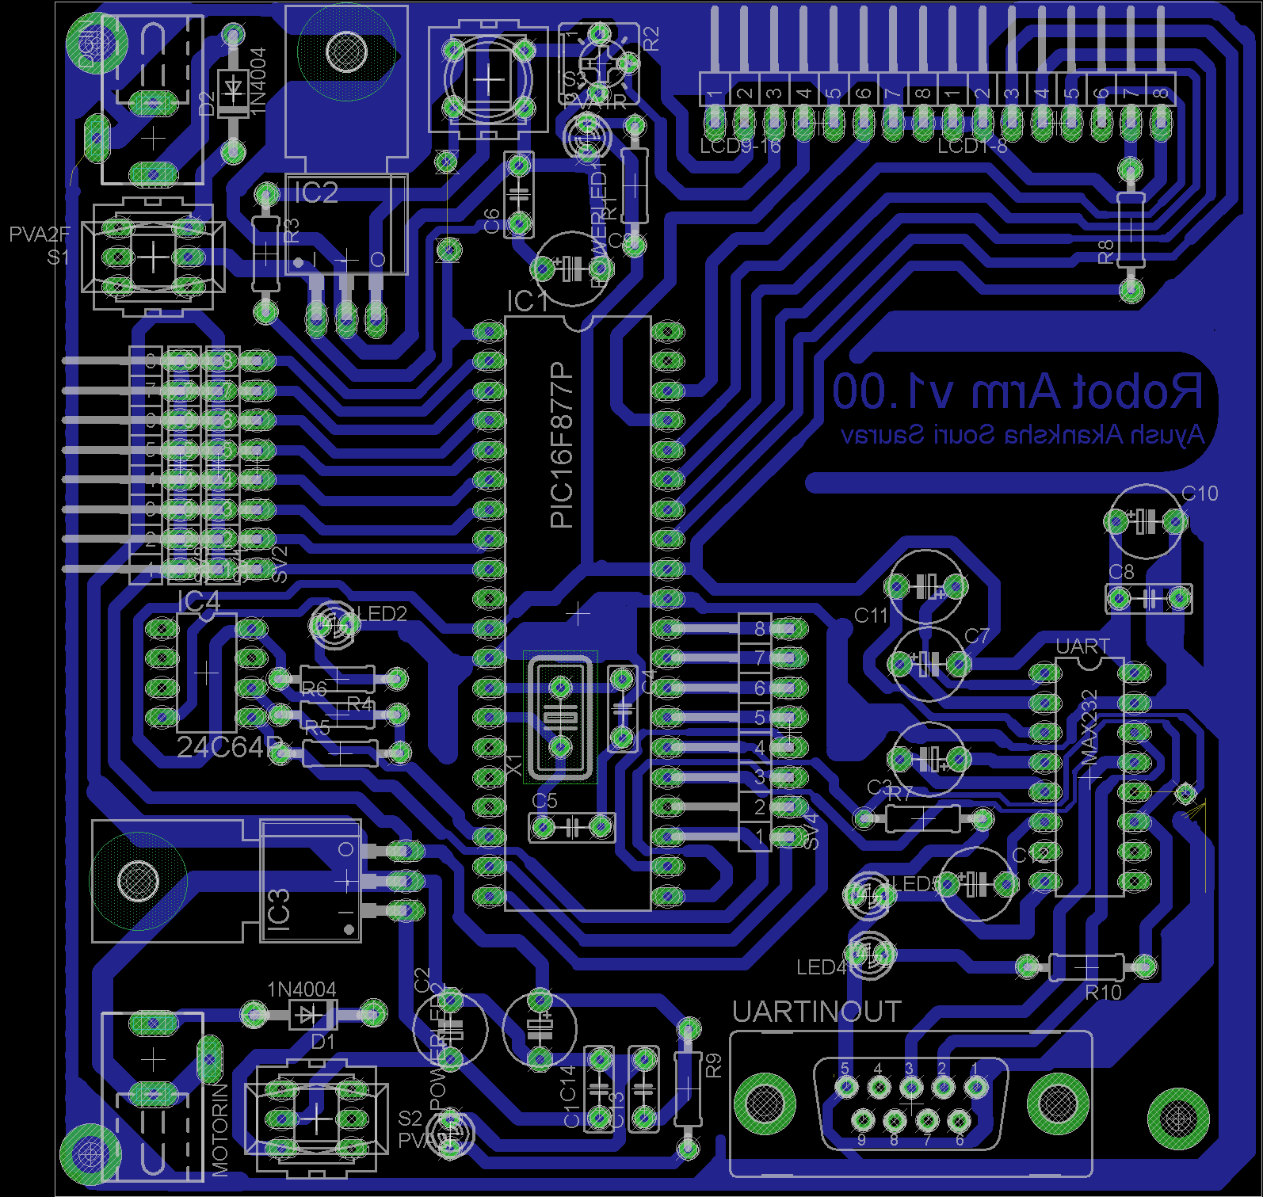
The Layout

Slide 27
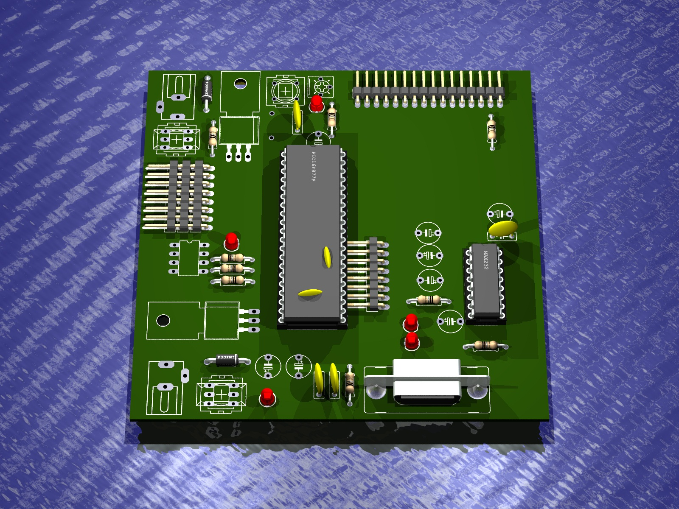
Generating the Layout in 3d – To prevent any misplaced component

Slide 28
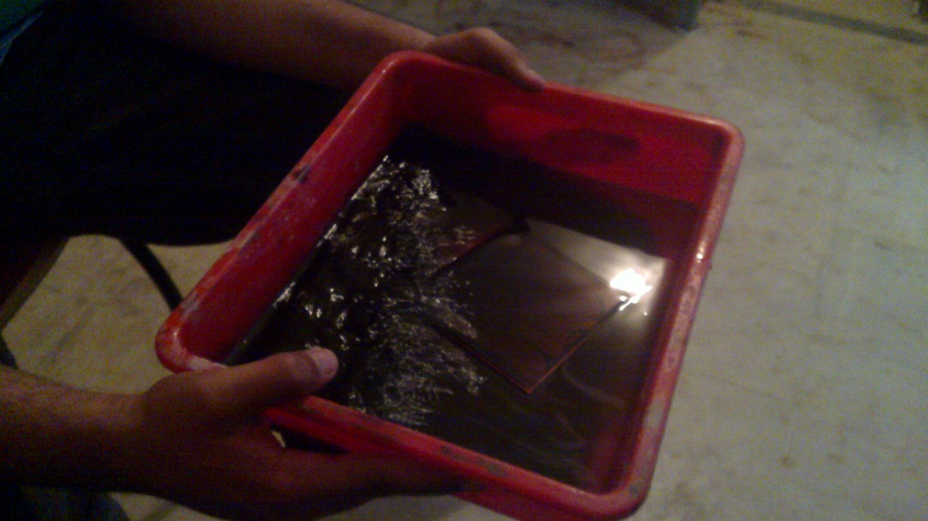
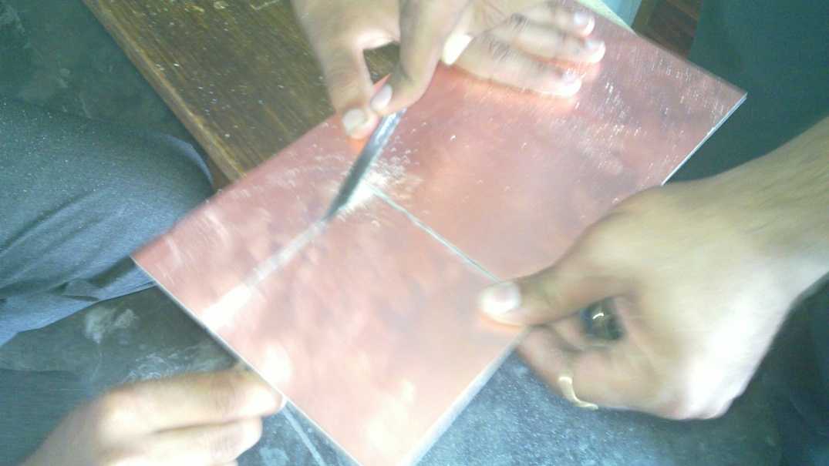
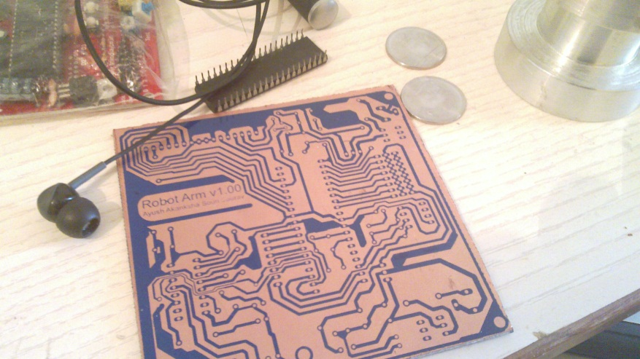
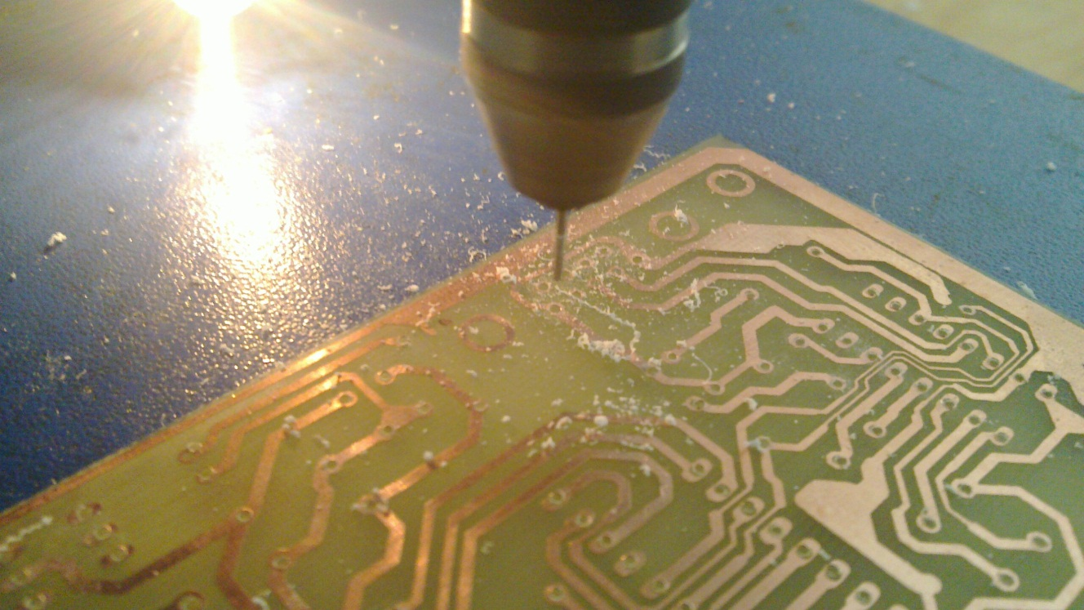
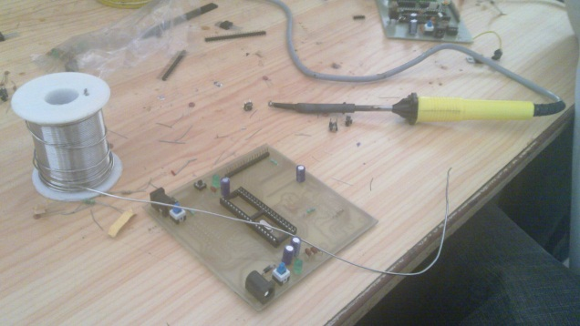
Getting the PCB Ready

Slide 29
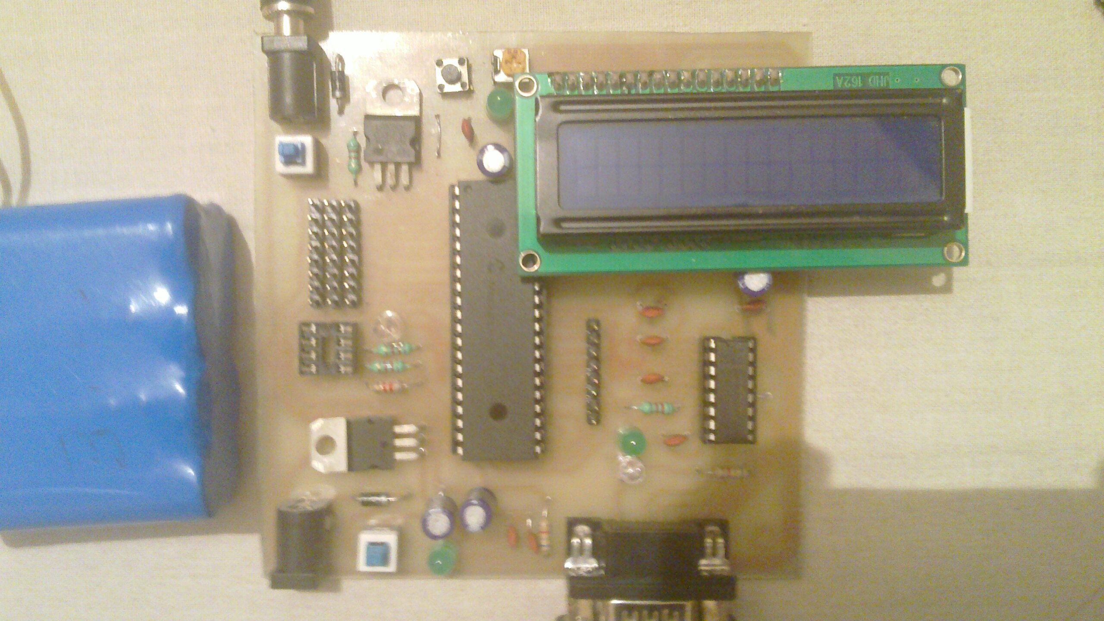
The Final PCB

Slide 30
Concept & Motivation
What we wanted
The big picture
Visualization
Distribution of Work
Mechanical Design
Resources and help
Design stages
Logic Overview
It’s all about building an intelligent device!
Electronic Design
Components we needed
Getting them to talk to each other
Development of the PCB
Programming the Brains of the Robot
Why LabVIEW?
Interfacing PIC with LabVIEW
Moving the first Motor
Remaining Work
Project Budget
ETA
Resources
Agenda

Slide 31
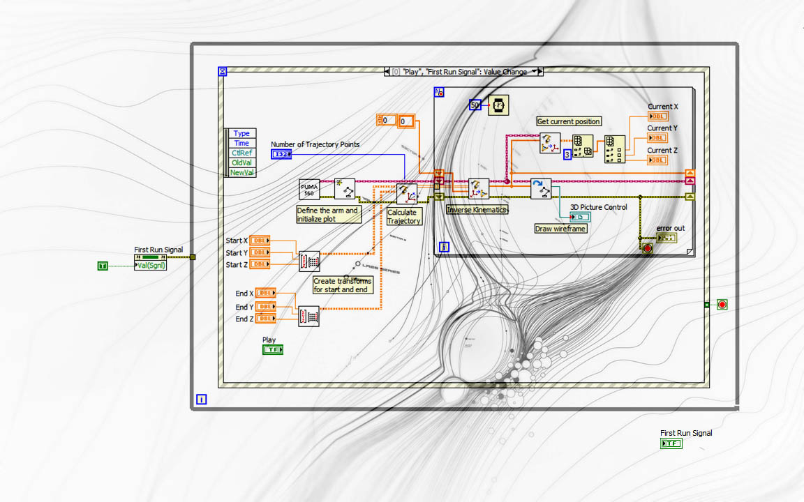

Robot Arm Controller Design in LabVIEW

Slide 32
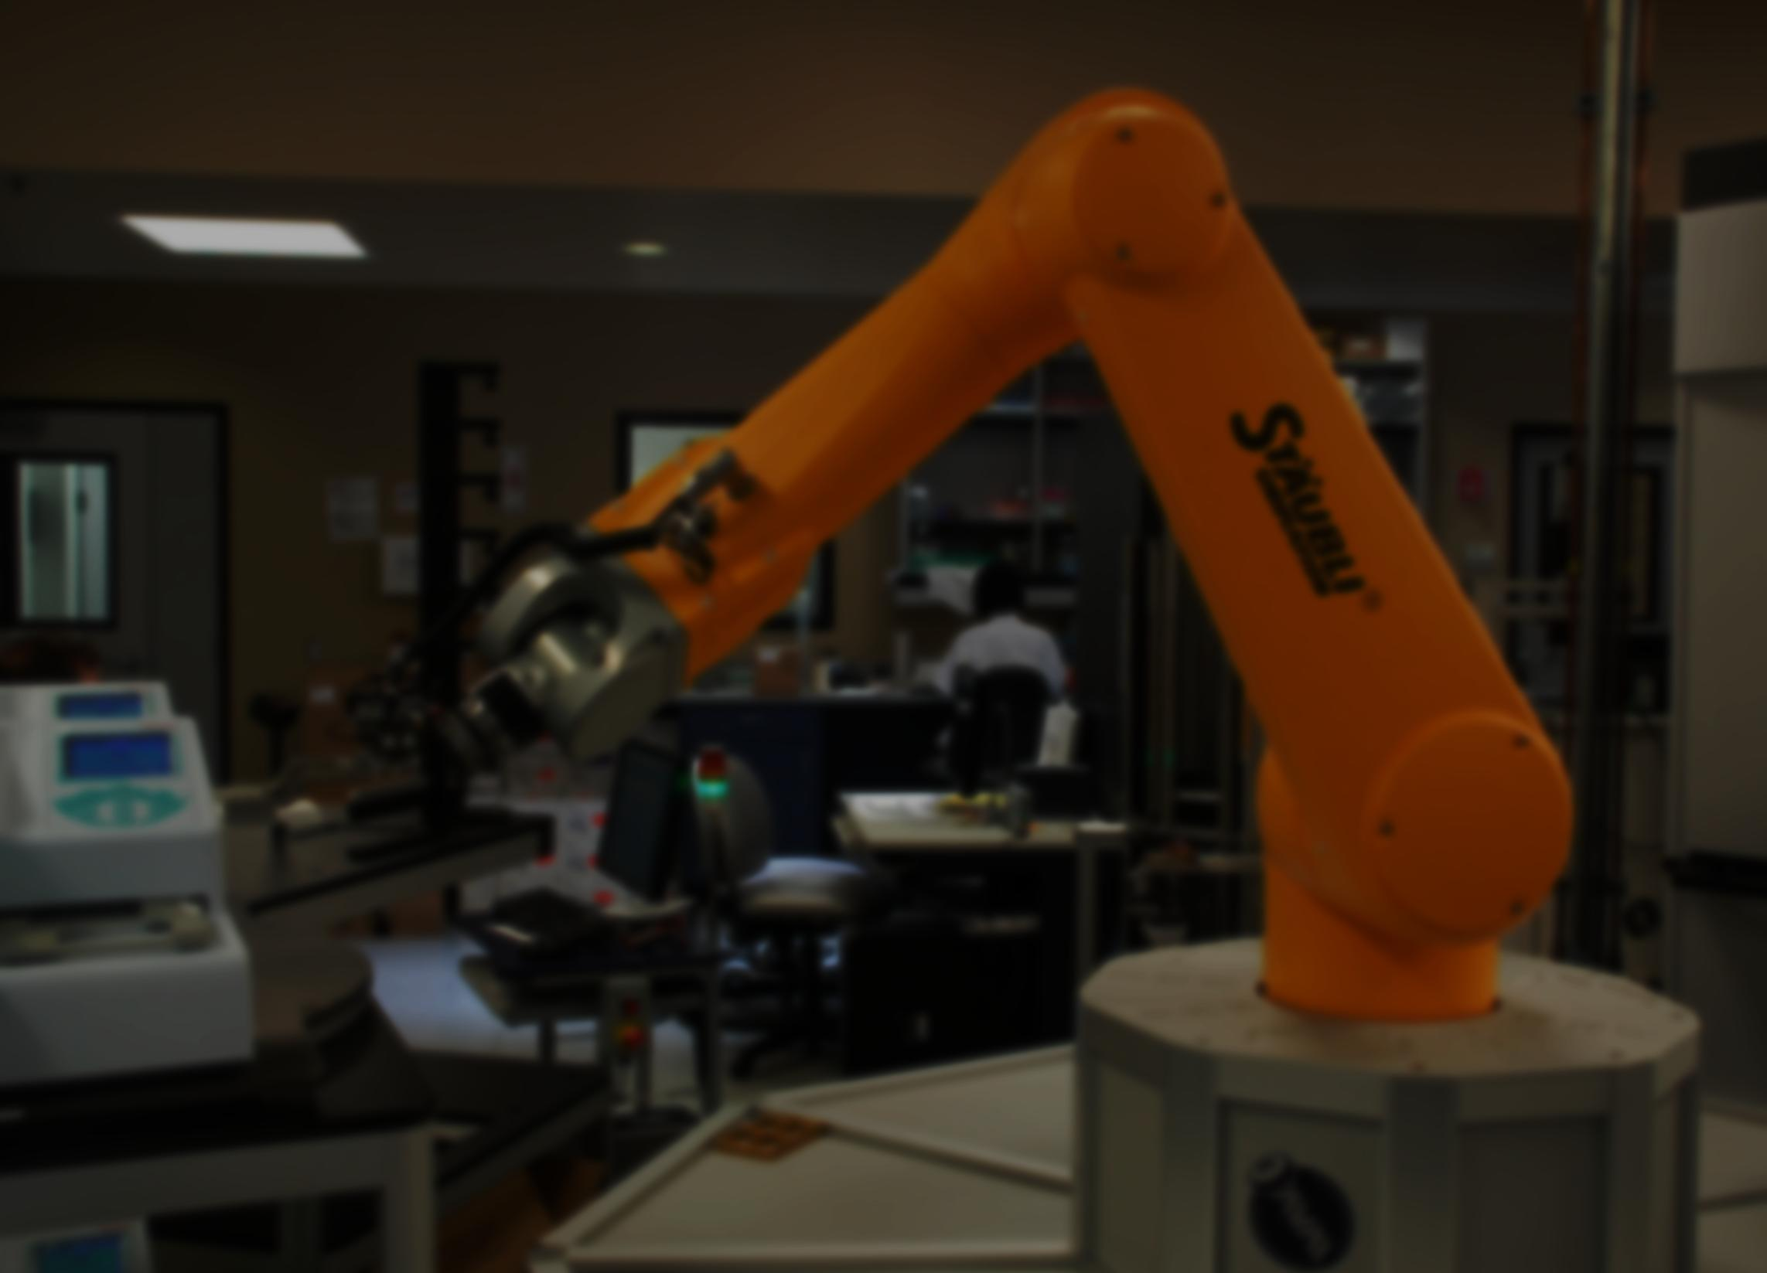
Get Robot Position
Get Error
Calculate Inverse Kinematics
PID Logic
Send Data to Controller
Generate PWM
PIC Microcontroller
Remote PC
Robot Arm
Serial/Ethernet Interface
Control Flow of a Single Cycle of Operation

Slide 33
Demonstration
Coding Technique
Logic
Kinematics Dynamics Matrices
Controller Design in LabVIEW
Proteus/LabVIEW Simulations

Slide 34
Acquisition of relevant data October ‘10
Research on different Design types and choosing the best possible November ‘10
Decide Robot Parameters November ‘10
Verification of Parameters in Robotics Toolbox for MATLAB November ‘10
Implementation of Arm Parameters in LabVIEW 2010 November ‘10
Re-Verification of Arm Parameters in LabVIEW 2010 November ‘10
Mechanical Design of Robot December ‘10
Manufacturing of Robot February ‘11
PCB Design for Robot February ‘11
PCB Manufacture February ‘11
Selection of Servo Motors January ‘11
Calibration of Motors January ‘11
PID Control Design and Implementation of different Modes March ‘11
Improvisation March-April ‘11
Implement further use cases and extend funcionality March-April ‘11
Estimated Project Timeline
Completed
Ongoing
Left

Slide 35
thank You!

